Slide 1
Rollout Resource for Bridge:
Kick-Off Deck
Note to our customers: These slides are a starting point for you. Please feel free to modify anything that isn’t relevant to your organization, including your specific pain points, initiatives, or language that are uniquely yours.
Internal note: these slides are intentionally left unbranded so customers can drop right into their own company templates.

Slide 2
Section 1: These slides are intended for your leadership team and managers but pick and choose what is relevant to your audience.

Slide 3
Bridge is a single place to manage our talent.
[Our company] will use Bridge to drive connection, alignment, and growth across our company.
Key outcomes we want to achieve with Bridge:
Understand skills strengths and gaps by establishing a shared framework across departments
Run smoother performance review cycles
Everyone completes mandatory training on time
More employees will engage in learning because it’s connected to their growth
Retain our best people by providing clear career pathways and opportunities for growth
OUR GOALS:
INSERT GOAL(S)

Slide 4
Why We’re Investing in Bridge
Visibility Into Organizational Strengths and Gaps
We get real-time skills gap reporting to understand our competencies and gaps.
Helping Our Managers Manage Better
Tools designed to help managers focus on employee development, goals, skills, and training.
Personalized Development
Bridge will automatically deliver the necessary learning to close any skills gaps.
Building a Mentorship Culture
Peer-to-peer growth via mentorship communities
Staying Compliant
Deliver and track all mandatory training that keeps our people safe and our company compliant

Slide 5
Some highlights of Bridge include:
Targeted Skills Development
Dynamic Skills Intelligence: Bridge utilizes real-time labor market data and a database of over 30,000 skills to map our current capabilities against global job trends. We can identify and close critical skill gaps we may not see otherwise.
Support for Our Managers: Bridge equips our managers with tools to set goals, provide structured feedback, and measure team growth. We want our managers to be talent developers versus task managers.
Automated Skill Building: Bridge tags all of our training content and serves it to people based on the skills they need or want to develop.
Accessibility and Reporting
Mobile App: Bridge is built to support our entire organization, even those without access to computers.
Analytics: Bridge provides reporting on course enrollments, progress, and gives talent insights.
Performance Insights
Goal Alignment: We can align every team’s goals to overarching company goals.
Career Pathing: Bridge will show every employee their career path within the company, highlight their skills gaps, and recommend training to help them progress.
Continuous Feedback: Everyone can request/give skills feedback to help peers assess knowledge and skill levels.

Slide 6

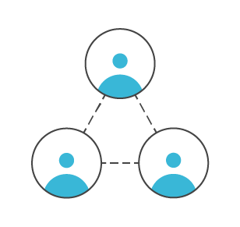
Connection
Understanding between employee and manager about career aspirations and role readiness
Opportunity to find mentors throughout the organization
Supports Managers as coaches
Feedback is a strong part of our culture
O U T C O M E :
Increased Employee Engagement

Slide 7

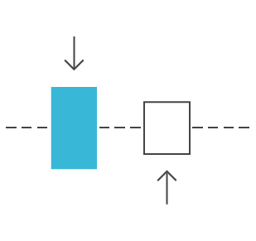
Alignment
Employees & Managers are in sync regularly
Employees have visibility that their work and their goals are aligned to company objectives
Strategy for skill development is based on actual data
Performance conversations are seamless
O U T C O M E :
Increased
Performance & Productivity
Notes:
grow revenue 58% faster and are 72% more profitable

Slide 8

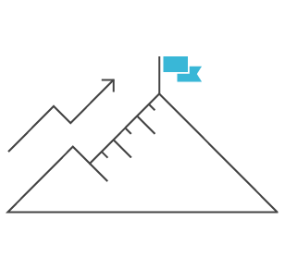
Growth
Employees can take the lead on their development
Employees are encouraged to map out a development plan and set goals to make progress towards that destination
Managers are enabled to help employees learn and grow
O U T C O M E :
Reduce Voluntary Turnover

Slide 9
What we can do in Bridge
Training
Skill Development
Deliver and measure mandatory training
New hire onboarding
Recommend learning based on skills/job title
Skills gap analysis for managers
Mentorship communities to build skills
Employee-led development plans
Performance Management
Engagement
Align company, team, and individual goals
Better manager conversations with 1:1 tools
Deliver performance reviews
Identify top performers
Run engagement surveys
Monitor employee sentiment

Slide 10
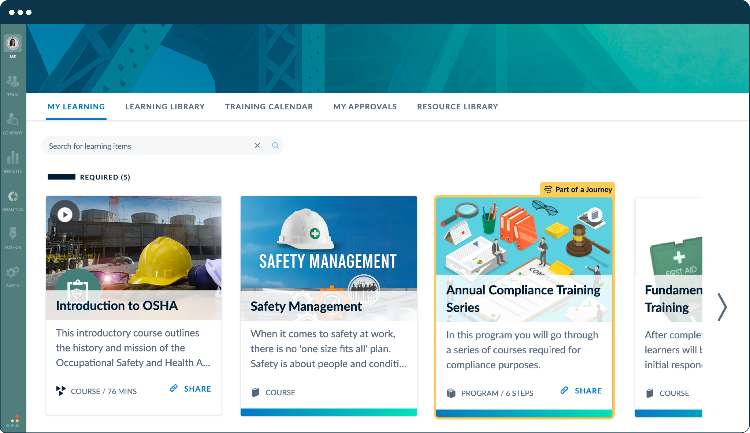
Centralize Training & Compliance
Mandatory Training: The hub for all role-essential certifications
Regulatory compliance: Meet state-specific requirements
Operational readiness: Ensure our team has the requirements needed to succeed.
GOAL: 100% completion by DATE

Slide 11
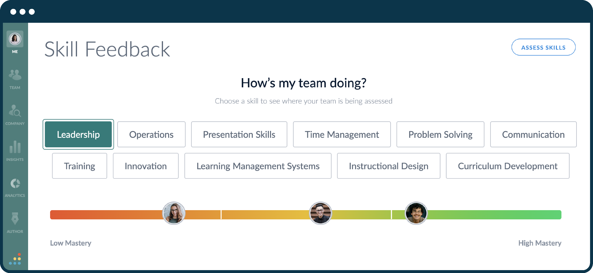
Identify skills/organizational strengths
Identify: Surface strengths and growth opportunities.
Analyze: Leverage data to drive talent development.
Support managers: Provide information to help coach/support.
GOAL: Every team by DATE

Slide 12
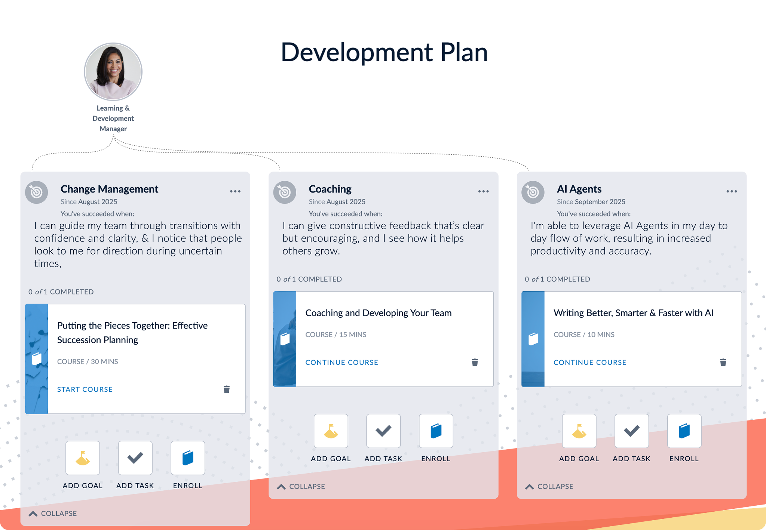
Employee-led development
Each employee can build a development plan and focus on three core skills. Bridge will also recommend learning to build knowledge.
GOAL: Development plans are built by DATE

Slide 13
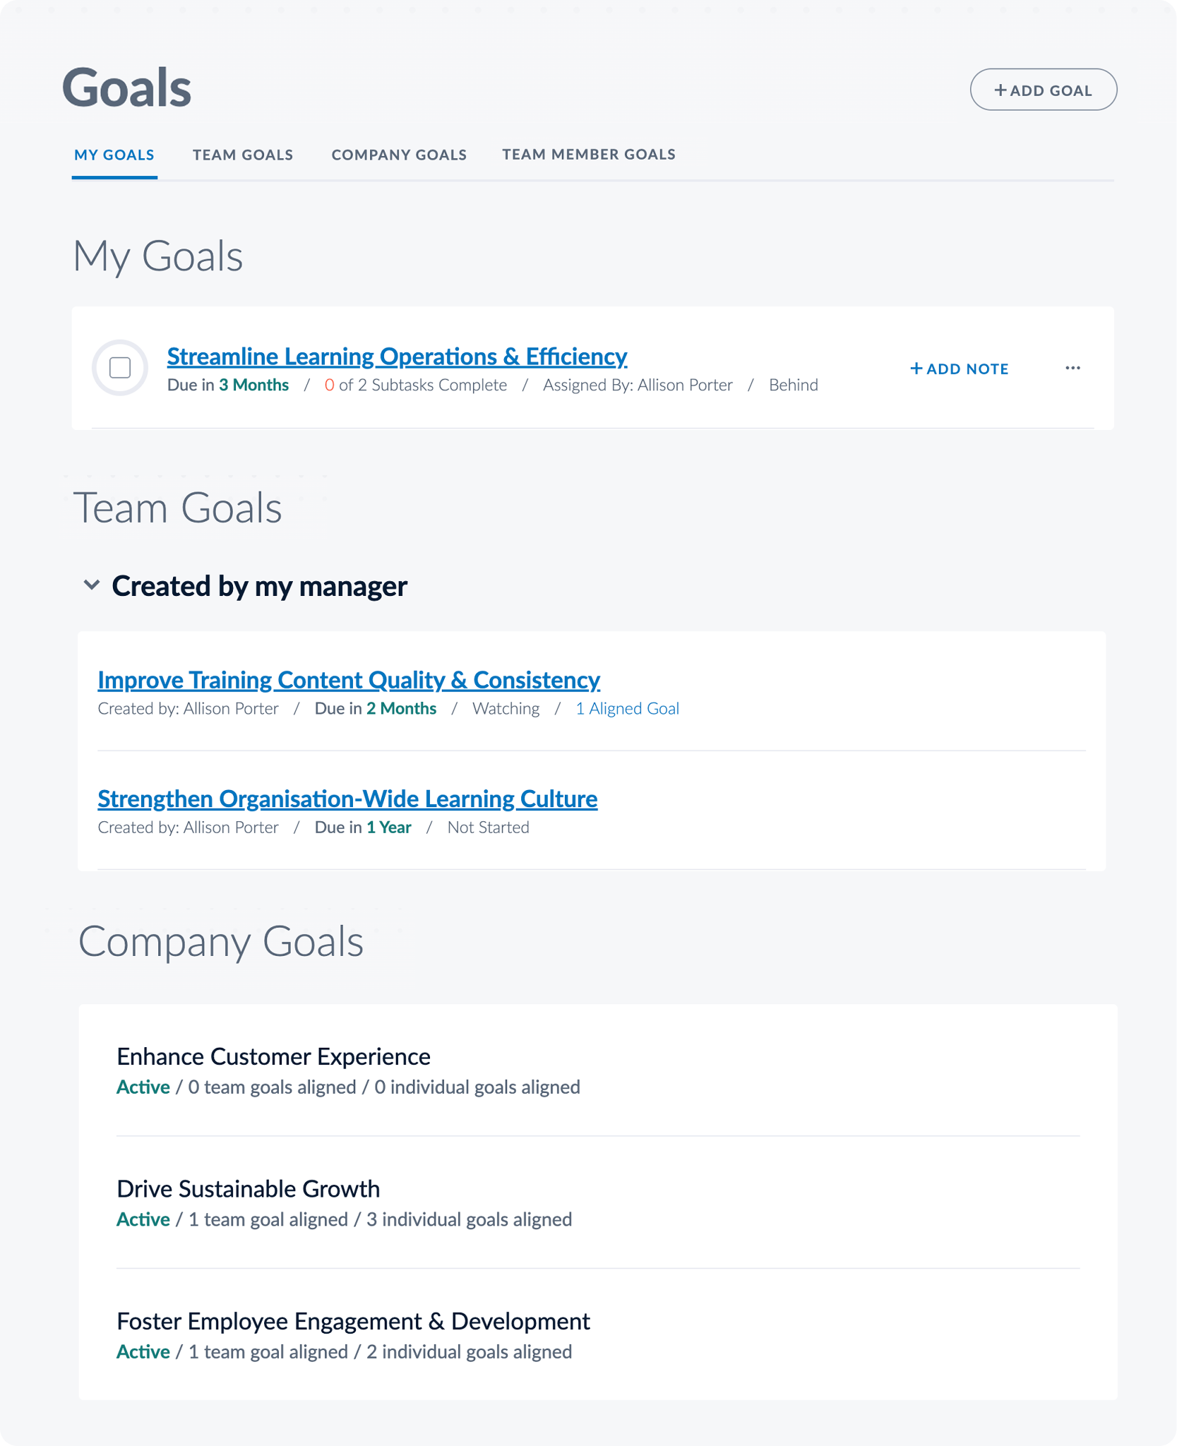
Track company-wide goals
Bridge aligns company, team, and individual-level goals, keeping people accountable, and connecting employee skills and performance.
GOAL: Every manager has their team goals into Bridge by DATE

Slide 14
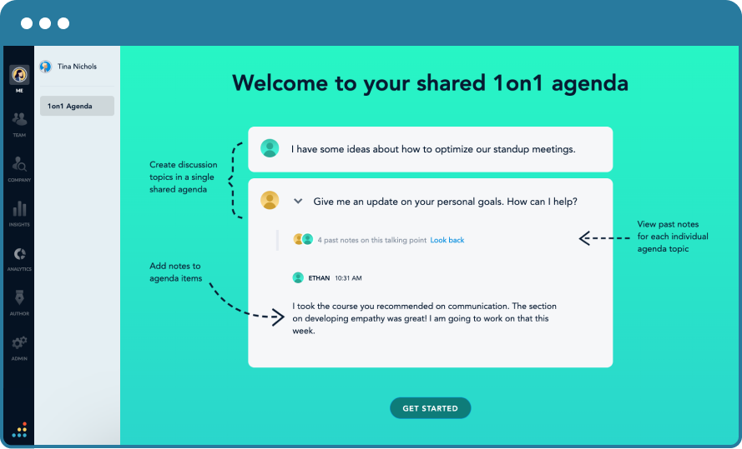
Help our managers manage better
Manager enablement tools designed to focus on employee development, goals, skills, and training.
Bonus: performance conversations should be happening more regularly which will lessen the work needed at performance review time.
GOAL: Everyone in the company is regularly using 1:1s by DATE

Slide 15
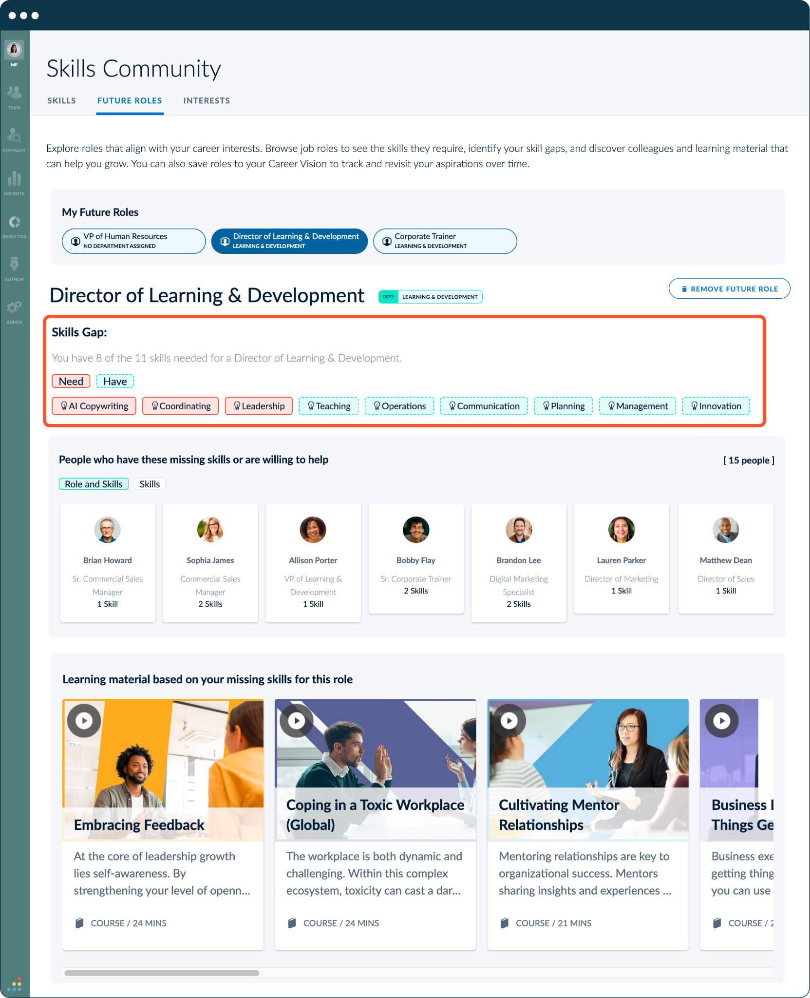
Build a mentorship culture
Bridge facilitates peer-to-peer growth. We can launch mentorship communities, connecting our internal experts with those who want to grow.
GOAL: Every employee has completed their skills profile by DATE and indicated whether they can mentor

Slide 16
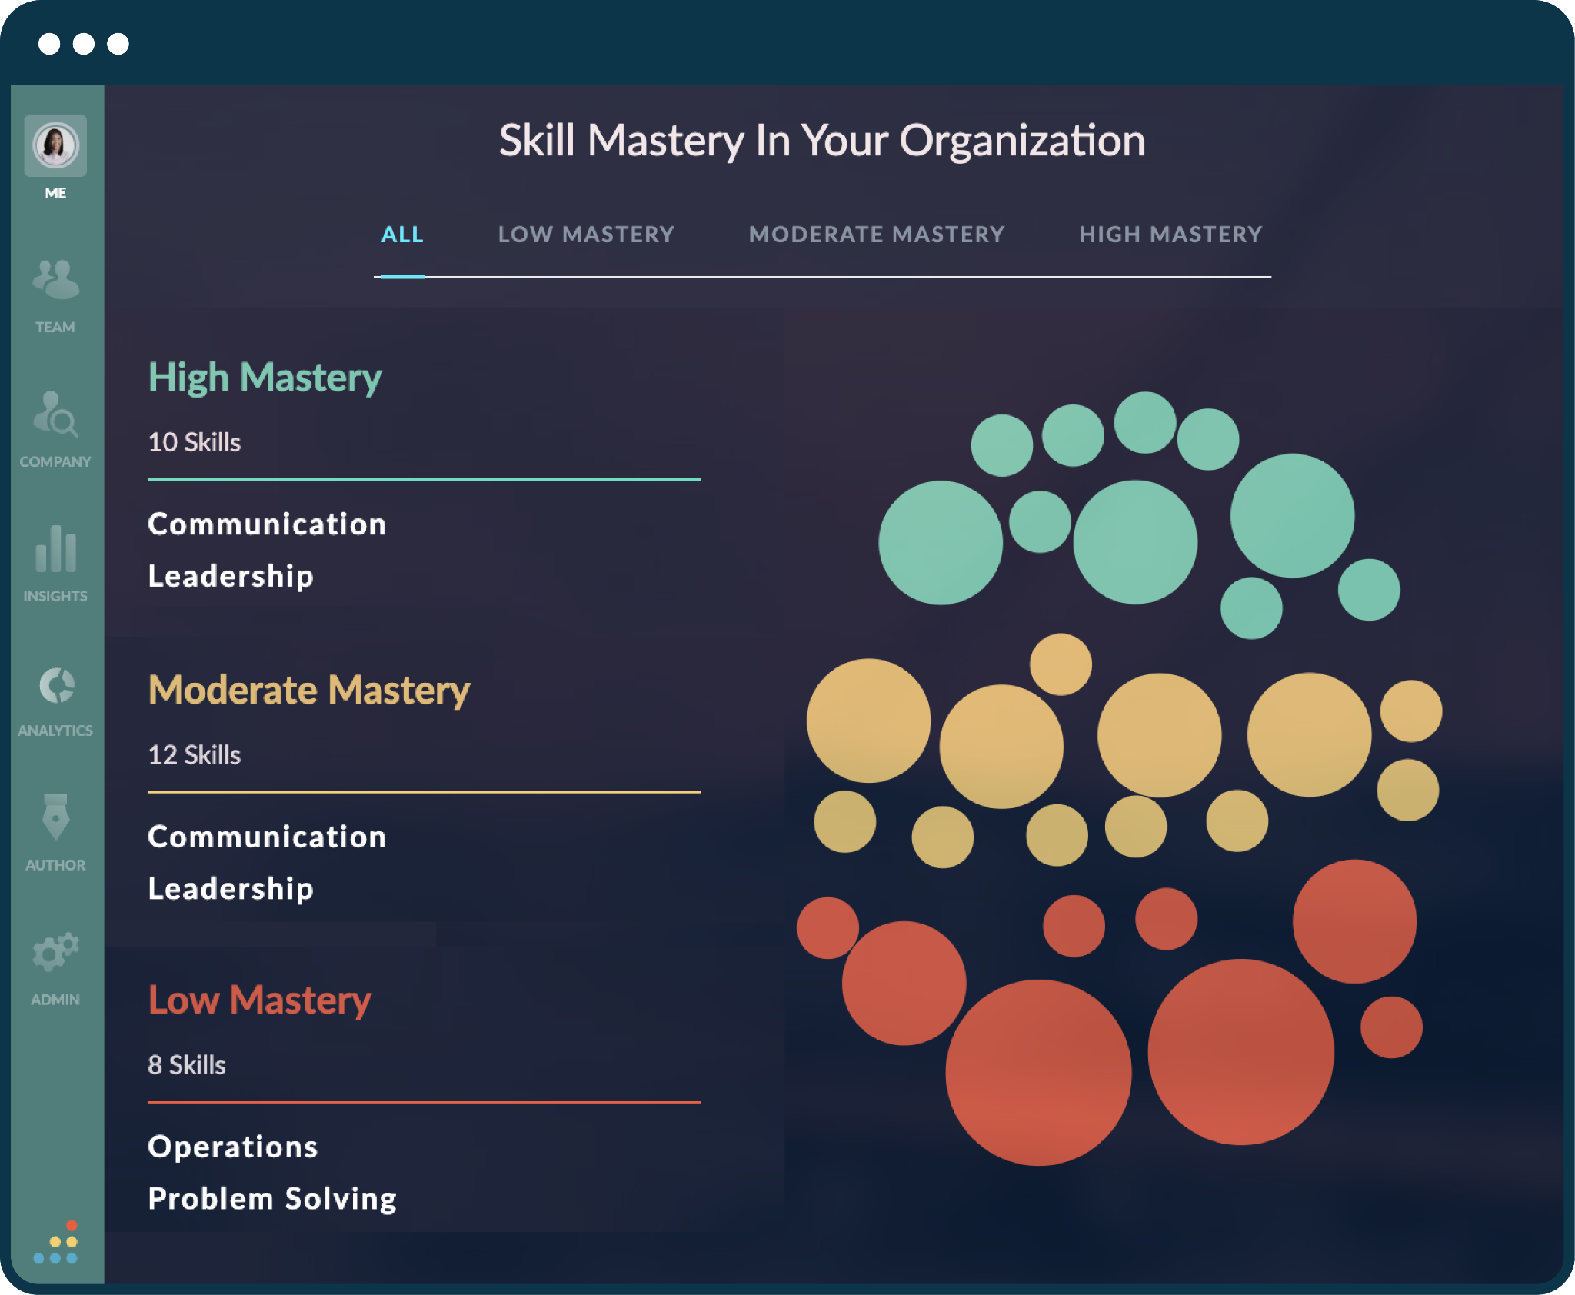
Retain our people and understand skills
Bridge will help us identify skills strengths and improvement areas across all departments.
GOAL: Every manager reviews skills feedback by DATE with their department leader

Slide 17
Ways we’ll measure success
100%
100%
95%
95%
99%
100%
00%
00%
METRICS
Skills mapped
Skills profiles completed
Development plans created
Individual and team goals added
In the first 30 days
In the first 45 days
In the first 60 days
In the first 60 days
Compliance training completion rates
On-time performance reviews
Skills gaps closed
Voluntary turnover
In the first year
In our first performance cycle
In the first year
Drop vol turnover by xx% within year one

Slide 18
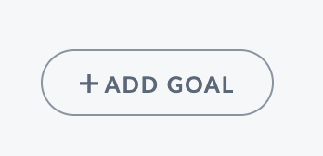
1
2
3
4
5
Complete Your Profile
Share a 1:1 Agenda
Fill in Your Goals
Request Skills Feedback
Create a Development Plan
Go to Me > My Profile
Go to Me > Goals
Go to Me > Feedback
Go to Team > 1on1
Go to Me > Development Plan
FIRST 90 DAYS EMPLOYEE ROLLOUT RECOMMENDATION
Fill out your profile. Be sure to add the skills you have, want to build and are willing to mentor.
Add new goals, subtasks and dates. Note: Managers should put in cascading goals.
Invite someone to give you a skills assessment. Tip: do this regularly versus solely at performance review time.
Create topics with your team. Add agendas, tasks. Managers should be regularly adding recognition when appropriate.
Choose three skills to focus on. Add goals, tasks, and learning. This should be discussed during a 1:1.

Slide 19
How you can help:
Research shows that HR tools succeed at a 68% higher rate when leadership is involved
Source: McKinsey & LiftHCM
Make Bridge a priority with your teams
Start using Bridge for 1:1s with your direct reports
Ask the managers on your teams to share insights from Bridge with you: development plans, skills gaps and 1:1s
Add skills to your profile, and encourage your teams to do the same

Slide 20
Section 2: These slides are intended for your employees

Slide 21
Bridge is a single place to learn and grow at [Our Company]
You will use Bridge to:
Complete yearly training
Understand your career path at the company
Build a development plan to gain new skills
Have better conversations with your manager
Track your goals and see how they map to company-wide goals
Learn!
OUR GOALS:
INSERT GOAL(S)

Slide 22
1
2
3
4
5
Complete Your Profile
Share a 1:1 Agenda
Fill in Your Goals
Request Skills Feedback
Create a Development Plan
Go to Me > My Profile
Go to Me > Goals
Go to Me > Feedback
Go to Team > 1on1
Go to Me > Development Plan
FIRST 90 DAYS IN BRIDGE
Fill out your profile. Be sure to add the skills you have, want to build and are willing to mentor.
Add new goals, subtasks and dates. Note: Managers should put in cascading goals.
Invite someone to give you a skills assessment. Tip: do this regularly versus solely at performance review time.
Create topics with your team. Add agendas, tasks. Managers should be regularly adding recognition when appropriate.
Choose three skills to focus on. Add goals, tasks, and learning. This should be discussed during a 1:1.

Slide 23
Section 2: These slides are intended for your employees

Slide 24
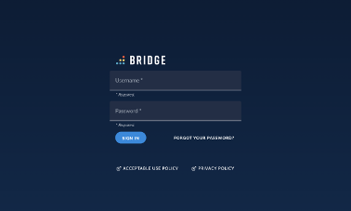
How do I log in?
You will receive an email notification from Bridge prompting you to create a password.
Your username will be your email address, and you'll always login at yourcompany.bridgeapp.com.
If you have any trouble logging in, please contact: INSERT CONTACT

Slide 25
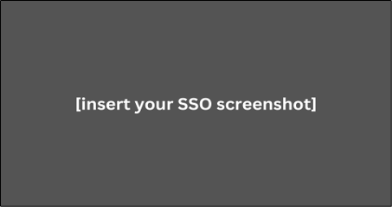
How do I log in? [If you are on SSO]
You will receive a welcome notification from Bridge with instructions to log in to Bridge.
You can always access the platform through SSO via our main dashboard.
If you have any trouble logging in, please contact: INSERT CONTACT

Slide 26
Detailed Employee Guide
Visit this page for detailed information on these areas of Bridge:
Career page
1on1 Agendas
Goals
Feedback
My Learning
Profile
If you have any trouble logging in, please contact: INSERT CONTACT

Slide 27
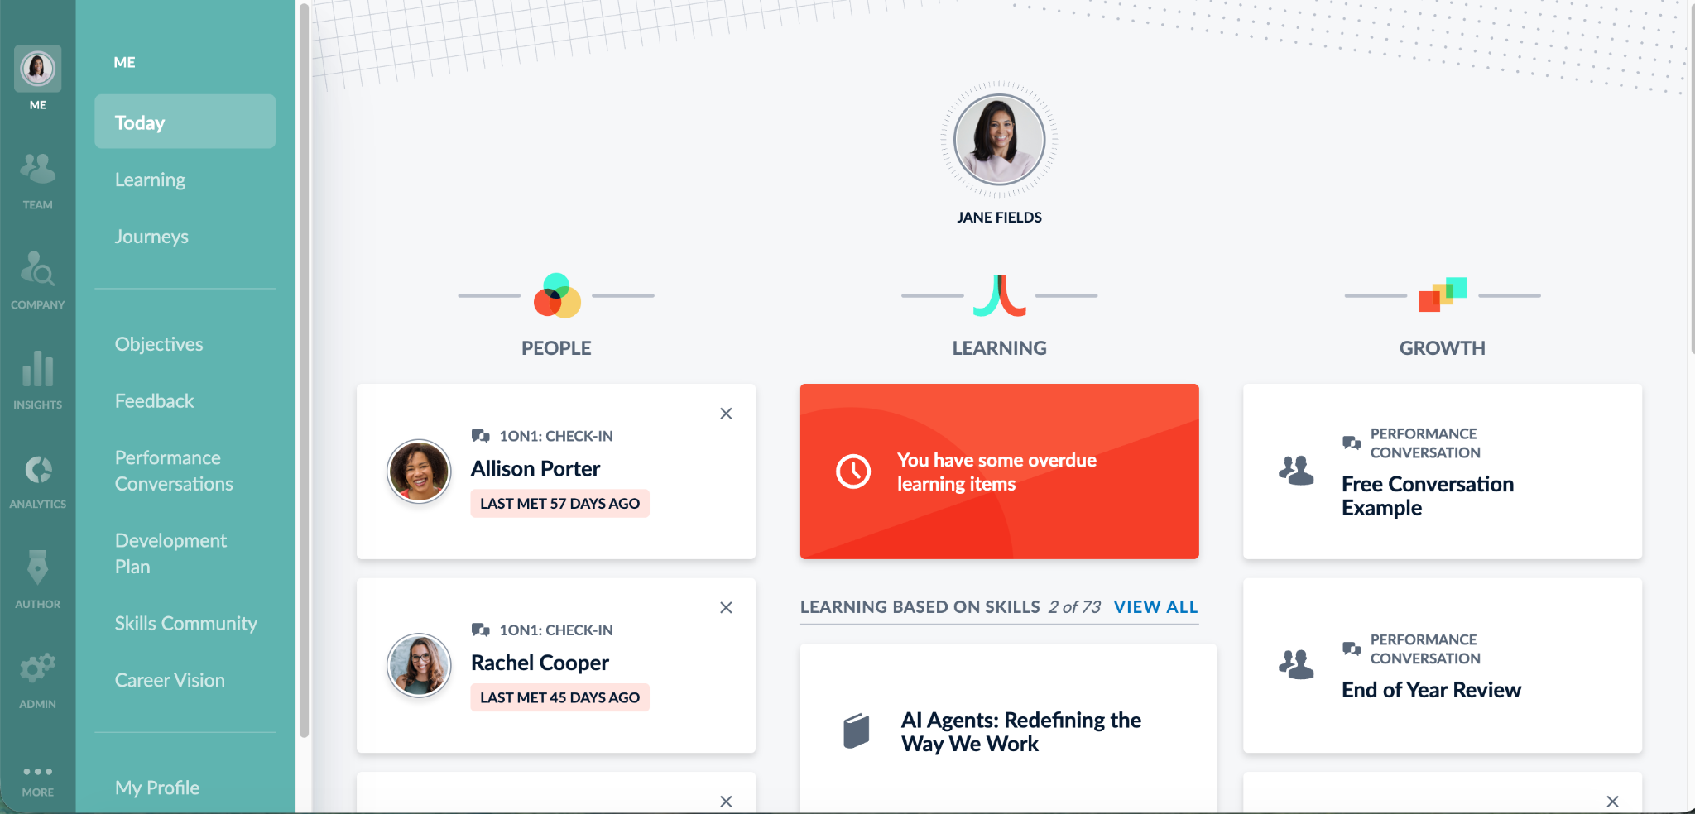
How do I access my training?
After logging into Bridge, you’ll see your homepage with three sections: People, Learning, and Growth.
Bookmarking this page is a great way to ensure you always have quick, direct access.
At the top, you’ll see your required trainings, which will turn red if they become overdue.
Below that, you’ll find recommended learning based on skills, followed by a list of your completed trainings.
If you have any trouble logging in, please contact: INSERT CONTACT

Slide 28
My Learning
Click on Learning on the left in the primary navigation.
At the top, you'll find:
My Learning: An overview of your learning items.
Learning Library: A catalog of optional learning to enroll in.
Training Calendar: Live, instructor-led training sessions.
Resource Library: Central repository of content
If you have any trouble logging in, please contact: INSERT CONTACT

Slide 29
How do I add skills to my profile?
Click My Profile in the navigation bar, then click the ‘Edit Profile’ button.
This section asks for:
A bit more about yourself
Asks for your phone number
Skills you have
Skill you want to develop
Skills you are willing to help someone develop
Interests
If you have any trouble logging in, please contact: INSERT CONTACT

