Slide 1
Rollout Resource for Bridge:
Kick-Off Deck
Note to our customers: These slides are a starting point for you. Please feel free to modify anything that isn’t relevant to your organization, including your specific pain points, initiatives, or language, to make it uniquely yours.

Slide 2
Section 1:
These slides are intended for your leadership team and managers, but pick and choose what’s relevant to your audience.

Slide 3
Bridge is a Single Place to Manage Our Talent.
[Our company] will use Bridge to drive connection, alignment, and growth across our company.
Key outcomes we want to achieve with Bridge:
Understand skills strengths and gaps by establishing a shared framework across departments
Everyone completes mandatory training on time
More employees engage in learning because it’s connected to their growth
Retain our best people by providing clear career pathways and growth opportunities
OUR GOALS:
INSERT GOAL(S)

Slide 4
Why We’re Investing in Bridge
Visibility Into Organizational Strengths and Gaps
We get real-time skills gap reporting to understand our competencies and gaps.
Helping Our Managers Manage Better
Tools designed to help managers focus on employee development, goals, skills, and training.
Personalized Development
Bridge will automatically deliver the necessary learning to close any skills gaps.
Building a Mentorship Culture
Peer-to-peer growth and knowledge transfer via mentorship communities.
Staying Compliant
Delivering and tracking all mandatory training that keeps our people safe and our company compliant

Slide 5
Some Highlights of Bridge Include:
Targeted Skills Development
Dynamic Skills Intelligence: Bridge utilizes real-time labor market data and a database of over 30,000 skills to map our current capabilities against global job trends. We can identify and close critical skill gaps we may not see otherwise.
Support for Our Managers: Bridge equips our managers with tools to check skills coverage, provide structured feedback, and measure team growth. We want our managers to be talent developers versus task managers.
Automated Skill Building: Bridge automatically tags all of our training content and serves it to people based on the skills they need or want to develop.
Accessibility and Reporting
Mobile App: Bridge is built to support our entire organization, even those without access to computers.
Analytics: Bridge provides reporting on course enrollments, progress, and gives talent insights.
Employee-Led Development
Development Plans: Employees get recommended skills based on their job titles. They can enroll in training to build these skills and set goals to make their growth measurable.
Career Pathing: Bridge will show every employee their career path within the company, highlight their skills gaps, and recommend training to help them progress.
Continuous Feedback: Everyone can request/give skills feedback to help peers assess knowledge and skill levels.

Slide 6

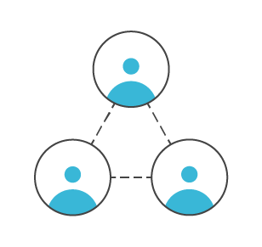
Connection
Understanding between employees and managers about career aspirations and role readiness
Opportunity to find mentors throughout the organization
Supporting managers as coaches
Feedback is a strong part of our culture
O U T C O M E :
Increased Employee Engagement

Slide 7

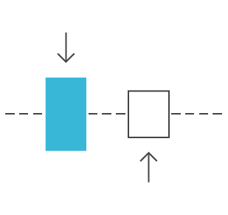
Alignment
Employees and managers are in sync regularly
Employees have visibility that their roles and competencies are aligned with company objectives
Strategy for skill development is based on dynamic industry data
Managers have visibility into team-wide capabilities and skills gaps
O U T C O M E :
Increased
Performance & Productivity
Notes:
grow revenue 58% faster and are 72% more profitable

Slide 8

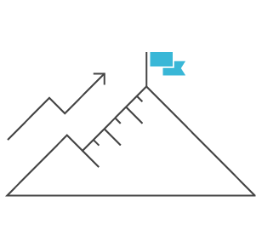
Growth
Employees can take the lead on their development
Employees are encouraged to map out a development plan and set goals to make progress towards that destination
Managers are enabled to help employees learn and grow
Employees can access a library of 150+ Skillsoft courses covering in-demand skills, pre-tagged and ready to use
O U T C O M E :
Reduced Voluntary Turnover

Slide 9
What we can do in Bridge
Training
Skills Development
Deliver and measure mandatory training
New hire onboarding
Recommend learning based on skills/job title
Skills gap analysis for managers
Mentorship communities to build skills
Employee-led development plans
Career Development
Analytics
Career pathing
Recommended job roles and skills gaps
Career drivers and personal vision statement
Employee skills gaps
Enrollments and course completion
Learner engagement and usage metrics

Slide 10
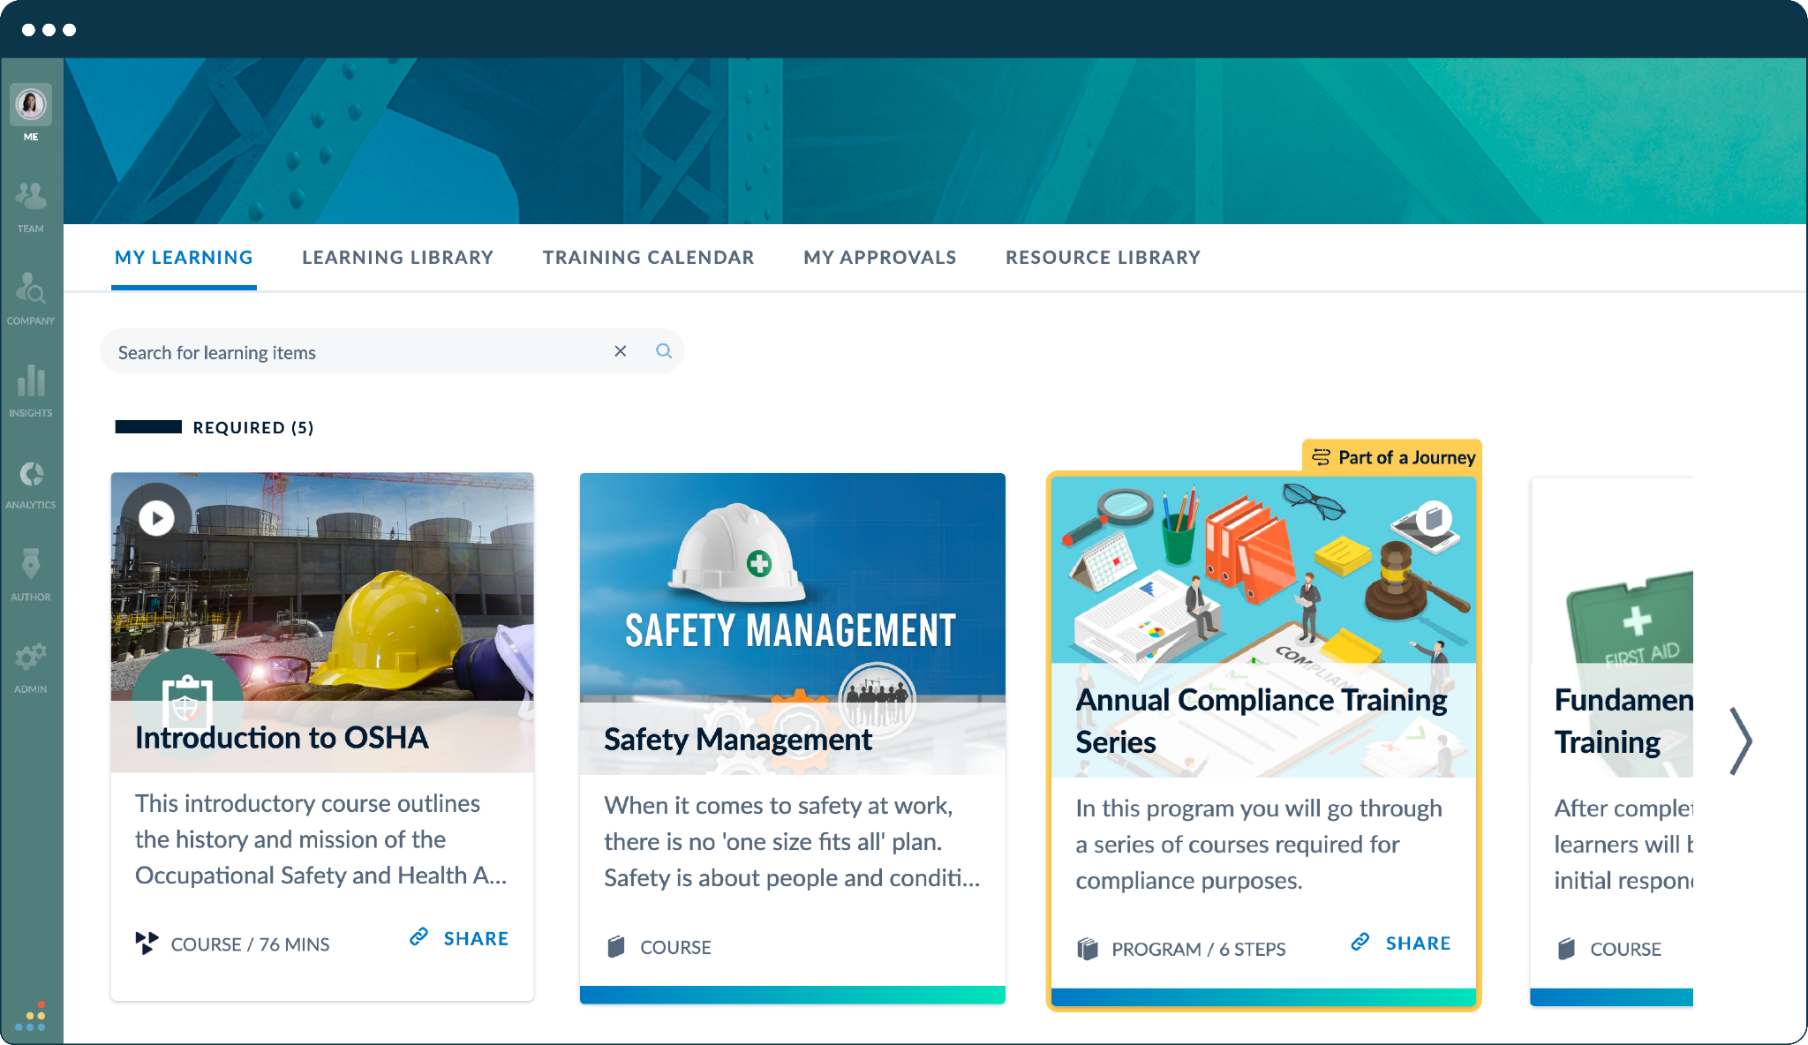
Centralize Training & Compliance
Mandatory training: The hub for all role-essential certifications.
Regulatory compliance: Meet state-specific requirements.
Operational readiness: Ensure our team has the requirements needed to succeed.
GOAL: 100% completion by [DATE]

Slide 11
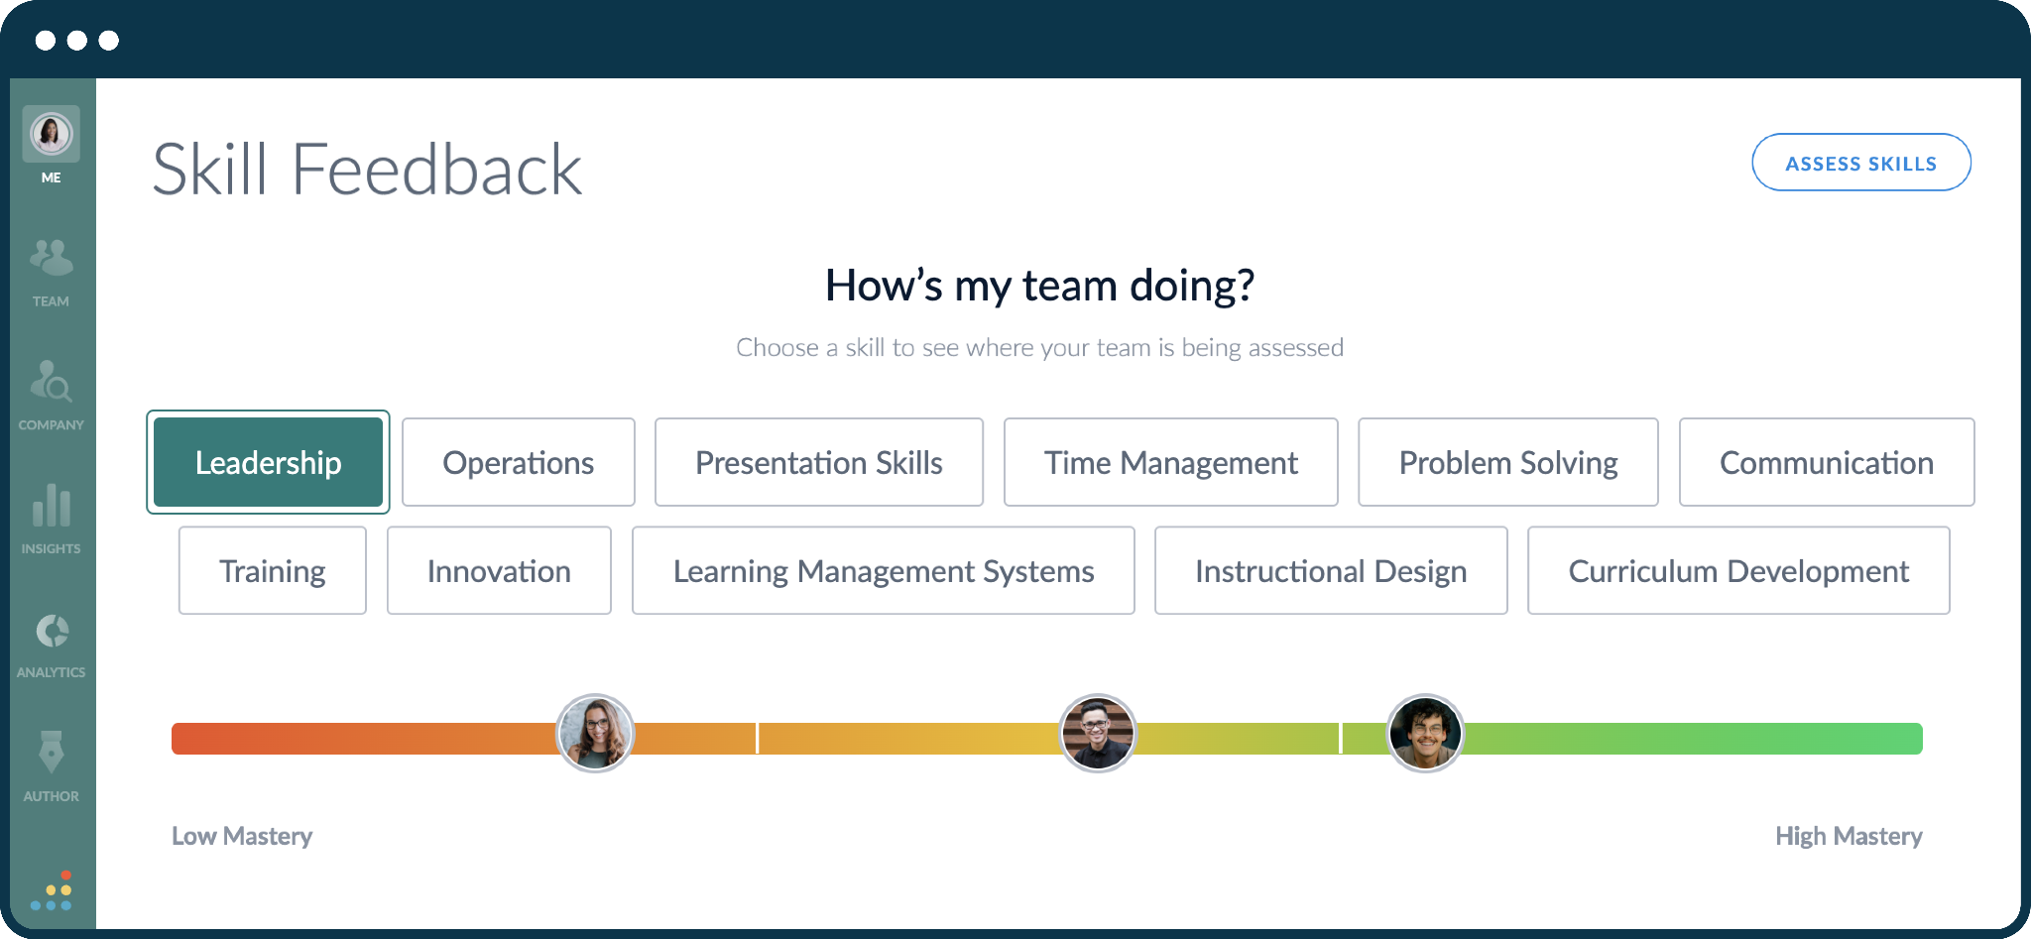
Identify Skills/Organizational Strengths
Identify: Surface strengths and growth opportunities in real time.
Analyze: Leverage data to drive talent development.
Support managers: Provide information to help coach/support.
GOAL: Every team by [DATE]

Slide 12
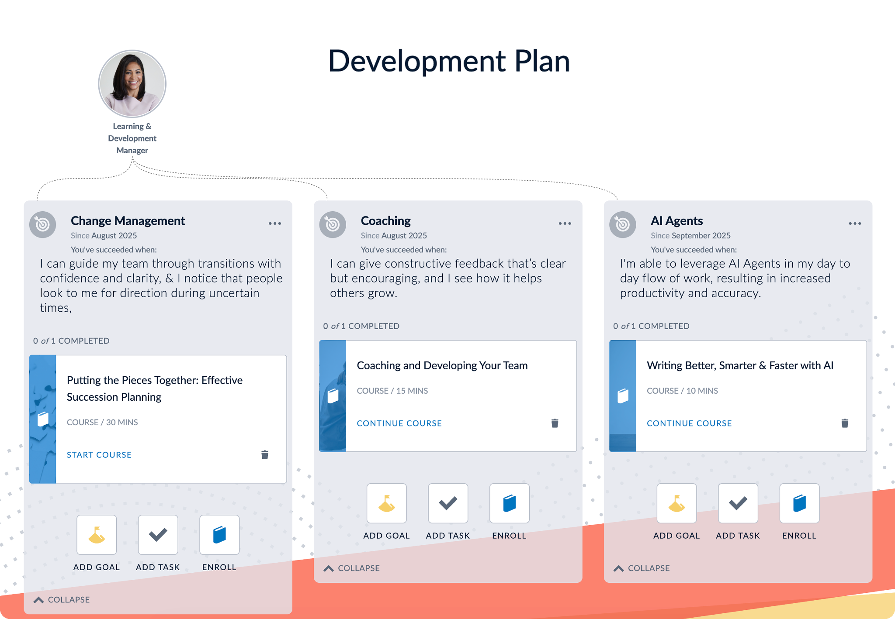
Drive Employee-Led Development
Each employee can build a development plan and focus on three core skills. Bridge will also recommend learning to build knowledge.
GOAL: Development plans are built by [DATE]

Slide 13
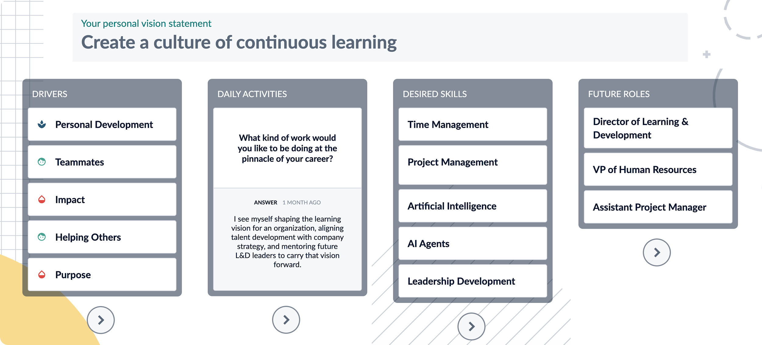
Discover What Drives Employees
Bridge’s Career Vision tools help employees discover their unique motivations. They can complete the Bridge Drivers exercise with their managers, and add a personal vision statement and daily activities.
GOAL: All employees complete Career Vision by [DATE]

Slide 14
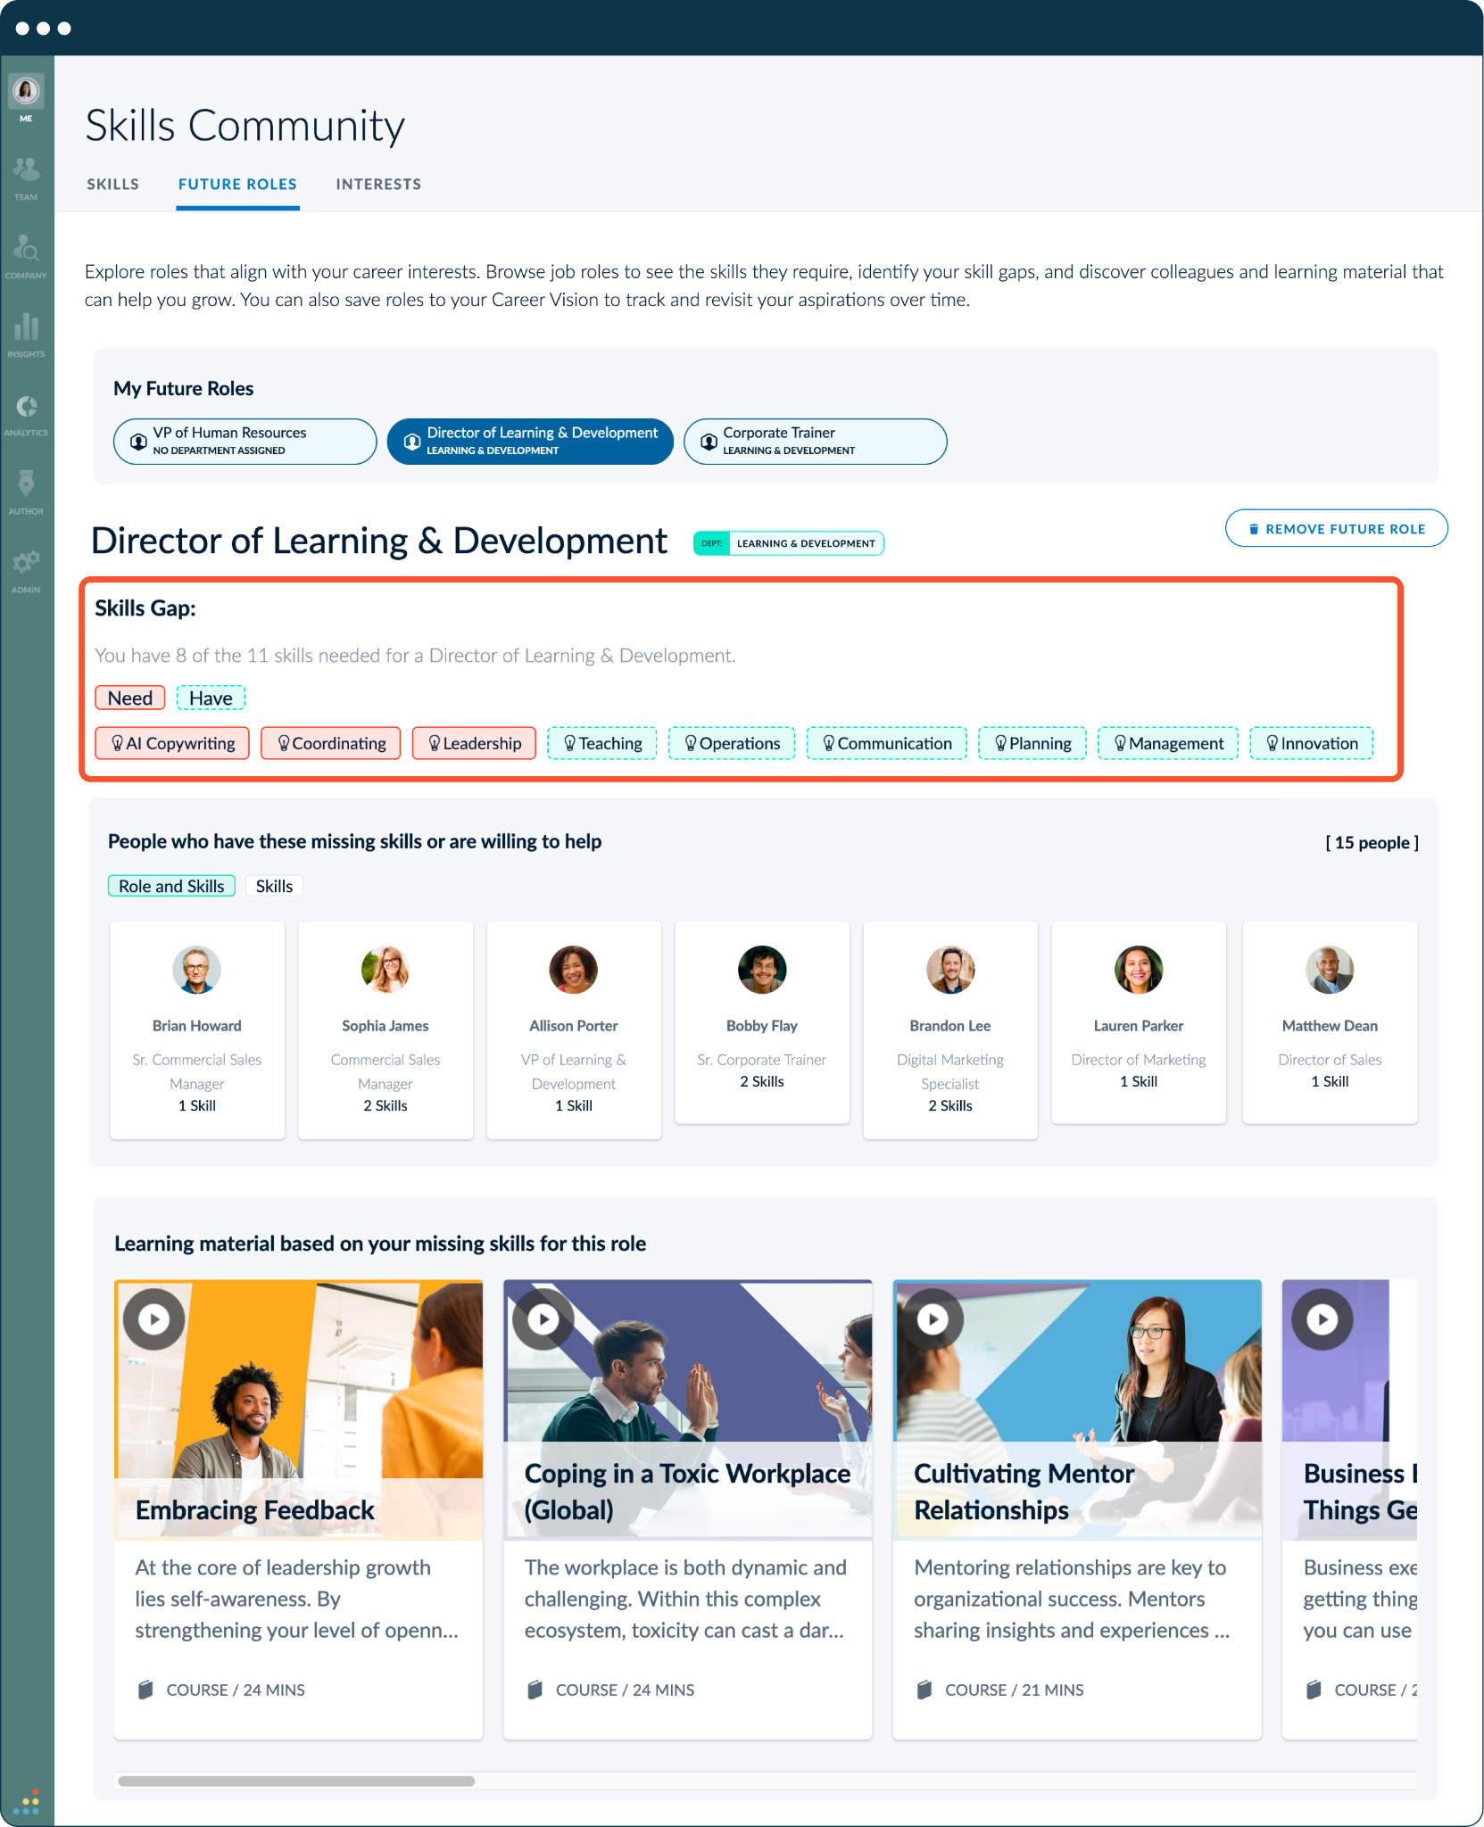
Build a Mentorship Culture
Bridge facilitates peer-to-peer growth. We can launch mentorship communities that connect our internal experts with those who want to grow.
GOAL: Every employee has completed their skills profile by [DATE] and indicated whether they can mentor

Slide 15
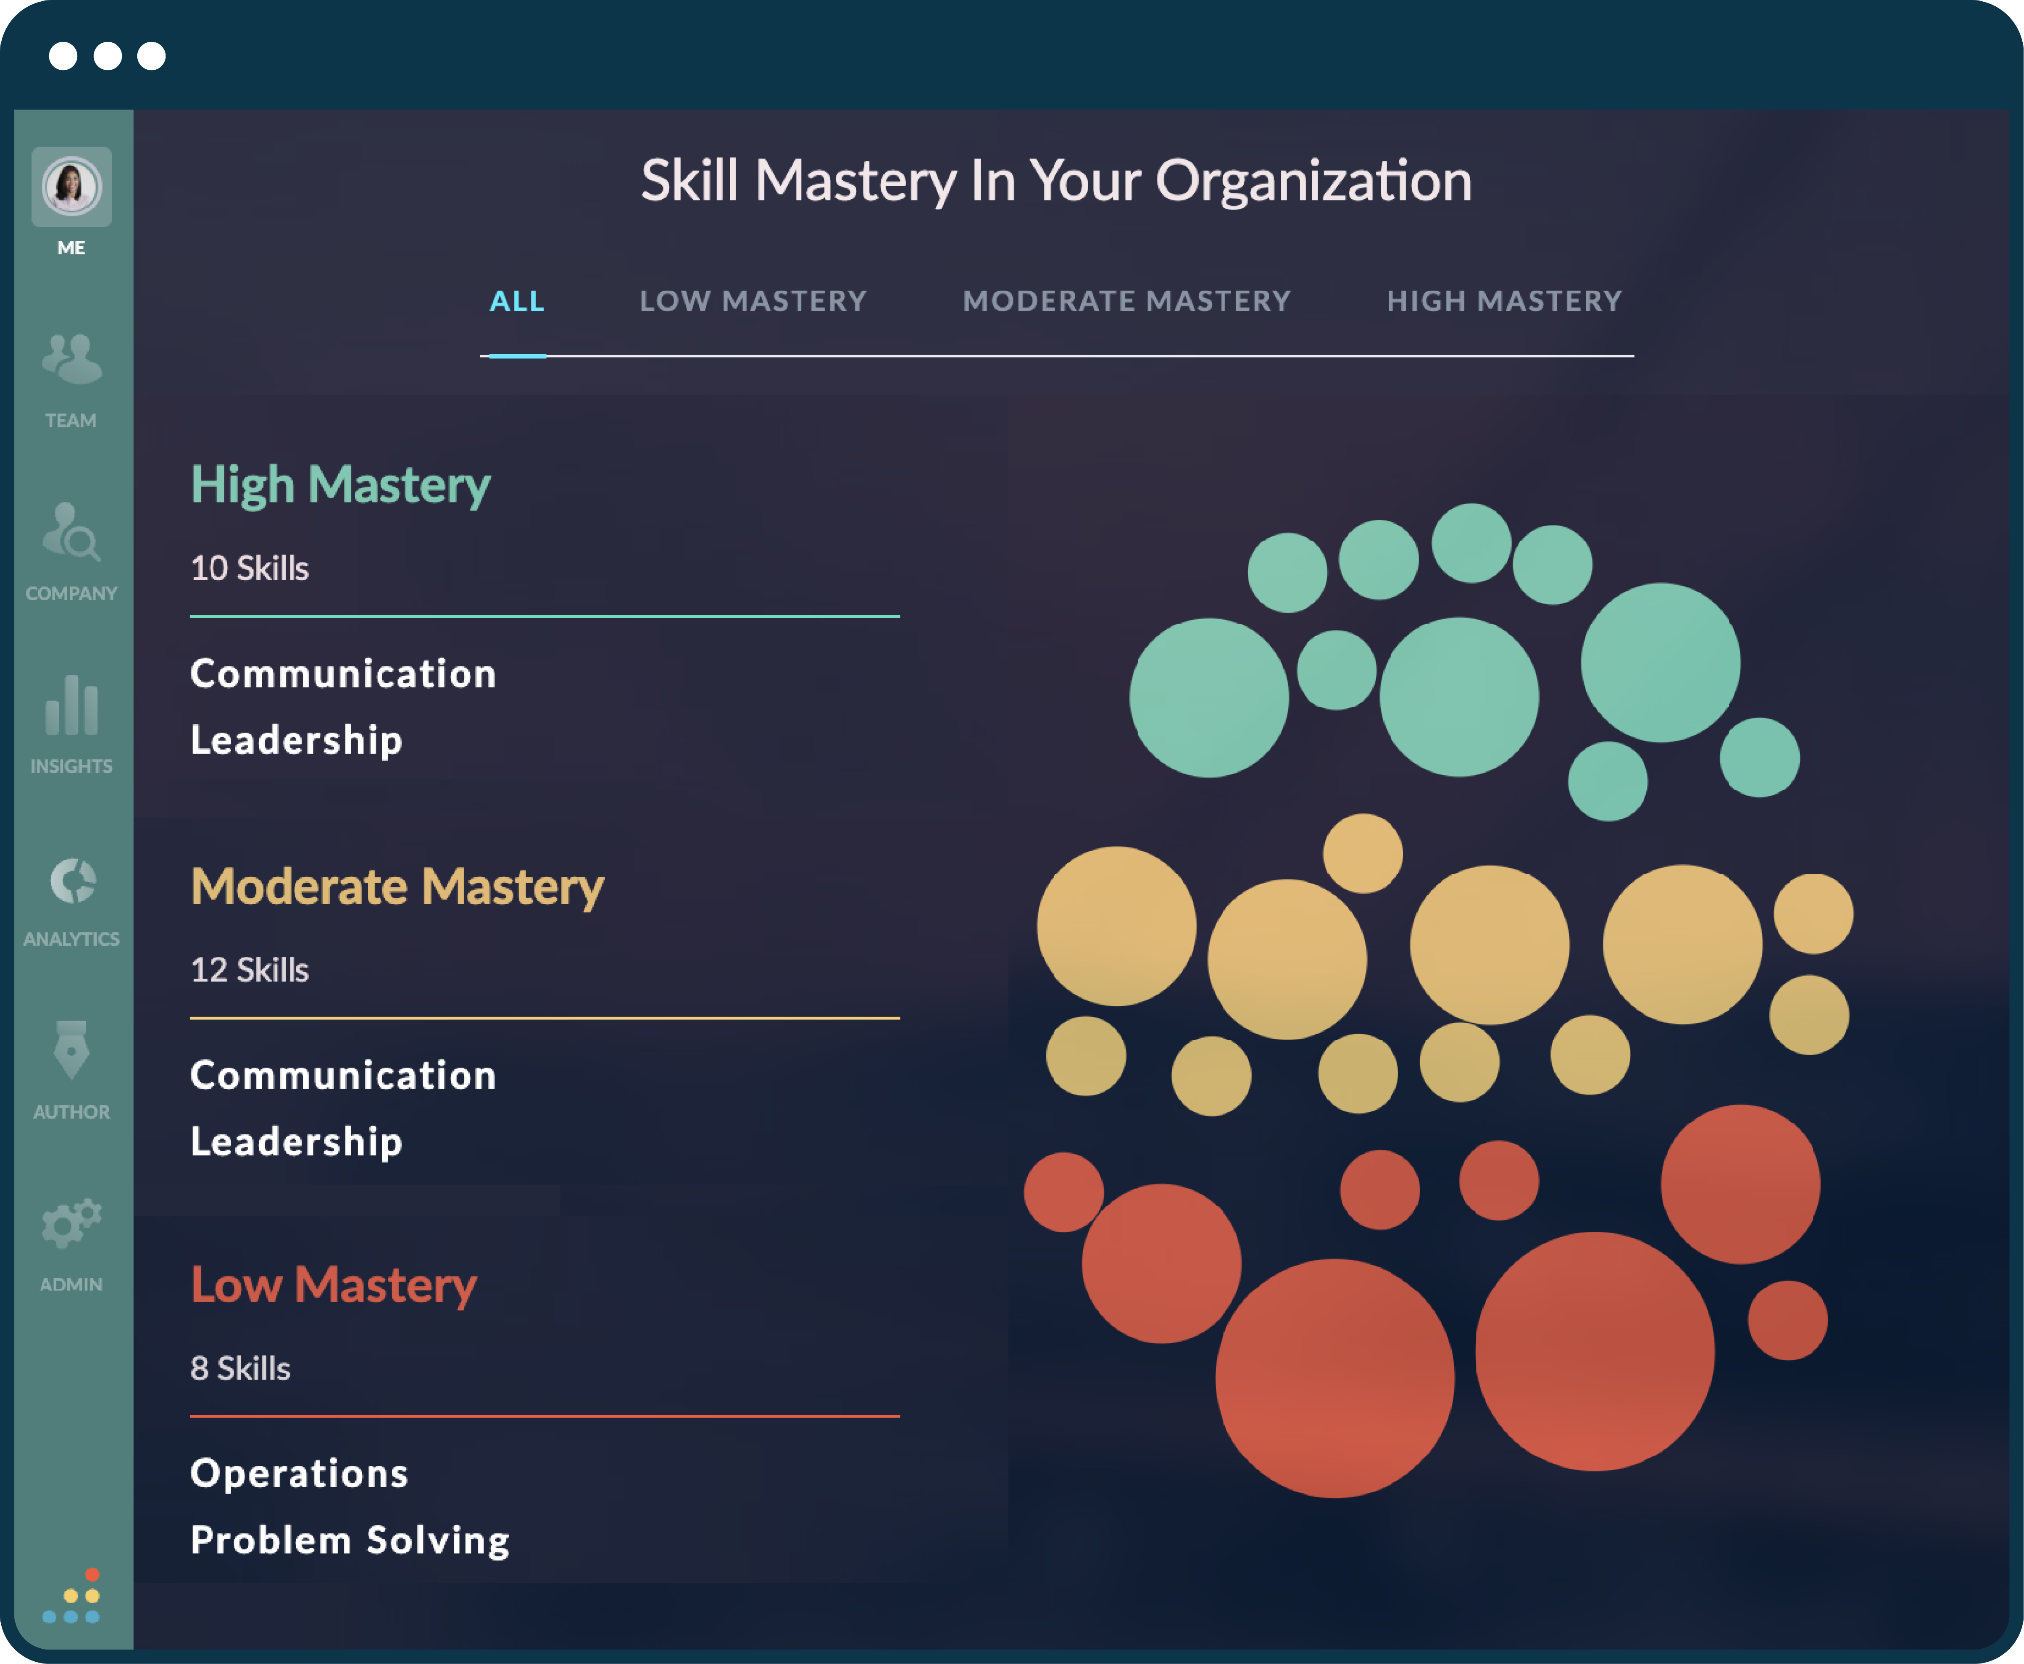
Keep Our Best People
Bridge will help us identify skills strengths and improvement areas across all departments.
GOAL: Every manager reviews skills feedback by [DATE] with their department leader

Slide 16
Ways We’ll Measure Success
100%
85%
95%
95%
99%
25%
50%
20%
METRICS
Skills mapped
Skills profiles completed
Development plans created
Feedback
In the first 30 days
In the first 45 days
In the first 60 days
Given in the first quarter
Compliance training completion rates
Internal mobility
Skills gaps closed
Voluntary turnover
In the first year
Employees promoted or moving into different roles in year one
In the first year
Drop vol turnover within year one

Slide 17
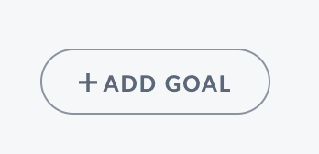
1
2
3
4
5
Fill Out Your Profile
Request Skills Feedback
Complete Your Required Training
Define Your Vision
Create a Development Plan
Go to Me > My Profile
Go to Me > Learning
Go to Me > Career Vision
Go to Me > Feedback
Go to Me > Development Plan
FIRST 90 DAYS EMPLOYEE ROLLOUT RECOMMENDATION
Fill out your profile. Be sure to add the skills you have, want to build, and are willing to mentor.
Find your required training in the My Learning tab. Overdue learning items will appear in the Needs Attention section.
Add a personal vision statement to outline what you want to achieve.
Tip: Career Drivers can help you define what motivates you.
Invite someone to give you a skills assessment.
Tip: Ask for feedback at least once per quarter.
Choose three skills to focus on. Add goals, tasks, and learning. This should be discussed during a 1:1.

Slide 18
How You Can Help
Make Bridge a priority with your teams
Ask the managers on your teams to share insights from Bridge with you: development plans, skills gaps, and feedback
Add skills to your profile, and encourage your teams to do the same
Research shows that HR tools succeed at a 68% higher rate when leadership is involved.
Source: McKinsey & LiftHCM

Slide 19
Section 2:
These slides are intended for your managers

Slide 20
Bridge is a single place to learn and grow at [Our Company]
You will use Bridge to:
Complete yearly training
Understand your career path at the company
Build a development plan to gain new skills
Have better development conversations with your manager
Connect with mentors, get feedback, and find personalized content recommendations to reach your career goals
Learn!
OUR GOALS:
INSERT GOAL(S)

Slide 21
1
2
3
4
5
Complete Your Profile
Complete Your Required Training
Define Your Vision
Request Skills Feedback
Create a Development Plan
Go to Me > My Profile
Go to Me > Learning
Go to Me > Feedback
Go to Me > Feedback
Go to Me > Development Plan
FIRST 90 DAYS IN BRIDGE
Fill out your profile. Be sure to add the skills you have, want to build, and are willing to mentor.
Find your required training in the My Learning tab. Overdue learning items will appear in the Needs Attention section.
Add a personal vision statement to outline what you want to achieve.
Tip: Career Drivers can help you define what motivates you.
Invite someone to give you a skills assessment.
Tip: Ask for feedback at least once per quarter.
Choose three skills to focus on. Add goals, tasks, and learning. This should be discussed during a 1:1.

Slide 22
Section 3:
These slides are intended for your employees

Slide 23
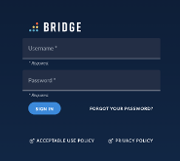
How Do I Log Into Bridge?
You’ll receive an email notification from Bridge prompting you to create a password.
Your username will be your email address, and you'll always log in at yourcompany.bridgeapp.com.
If you have any trouble logging in, please contact: [INSERT CONTACT]

Slide 24
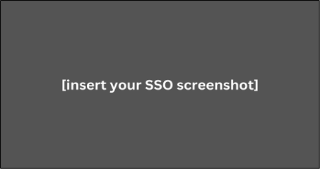
How Do I Log Into Bridge? [If you are on SSO]
You’ll receive a welcome notification from Bridge with instructions to log in.
You can always access the platform through SSO via our main dashboard.
If you have any trouble logging in, please contact: [INSERT CONTACT]

Slide 25
Detailed Employee Guidance
Find detailed information on the following areas of Bridge:
Career Vision
Development plans
Career pathing
Feedback
My Learning
Profile
If you have any trouble logging in, please contact: [INSERT CONTACT]

Slide 26
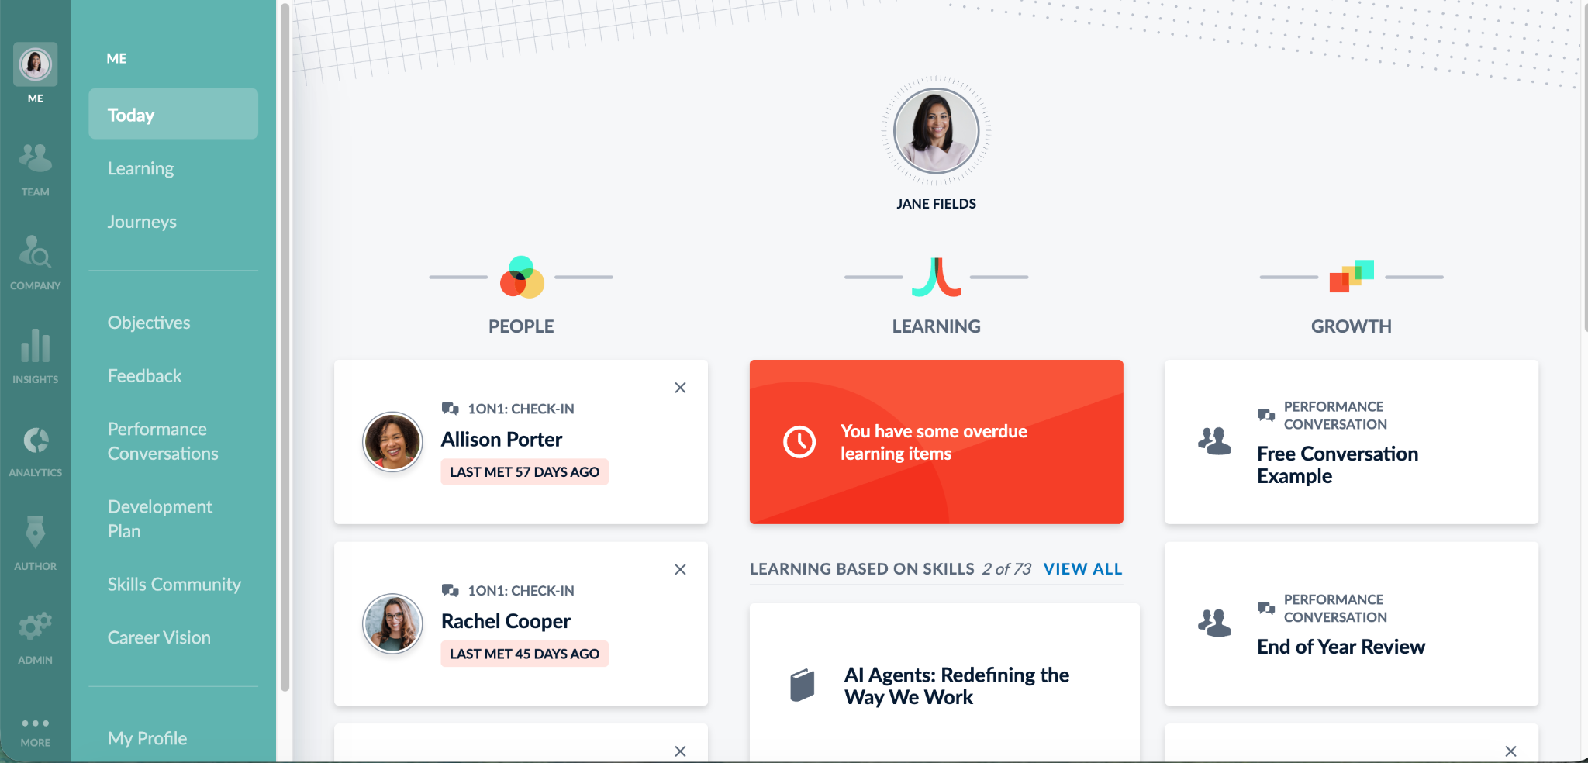
How Do I Access My Training?
After logging into Bridge, you’ll see your homepage with three sections: People, Learning, and Growth.
Bookmarking this page is a great way to ensure you always have quick, direct access.
At the top, you’ll see your required trainings, which will turn red if they become overdue.
Below that, you’ll find recommended learning based on your skills, followed by a list of your completed trainings.
If you have any trouble logging in, please contact: [INSERT CONTACT]

Slide 27
Navigating My Learning
Go to Me >Learning on the left in the primary navigation.
At the top, you'll find:
My Learning: An overview of your learning items.
Learning Library: A catalog of optional learning to enroll in.
Training Calendar: Live, instructor-led training sessions.
Resource Library: A central repository of content.
If you have any trouble logging in, please contact: [INSERT CONTACT]

Slide 28
How Do I Add Skills to My Profile?
Click My Profile in the navigation bar, then click the ‘Edit Profile’ button.
This section asks for:
A bit more about yourself
Your phone number
Skills you have
Skill you want to develop
Skills you’re willing to help someone develop
Interests
If you have any trouble logging in, please contact: [INSERT CONTACT]

